Slide 1
Developing accounting requirements for PBE Combinations
A PBE combination is the bringing together of separate operations into one reporting entity.
Anthony Heffernan – Director of Accounting Standards
April 2018
Notes:
IPSAS 40 Public Sector Combinations was approved for issue by the IPSASB at their December 2016 meeting and issued in late January 2017.
The NZASB and Staff have followed the development of the project from inception. However, it is always useful to consider the final product and how all the different elements come together in the Standard, hence the reason for this Education Session.
The new Standard fills a significant gap in the current IPSASB literature. Previously, IPSASs did not provide guidance on how to account for public sector combinations. Instead preparers were required to develop their own accounting policies based on other international and national accounting standards.
In New Zealand we have used IFRS 3 (i.e. PBE IFRS 3) for public sector combinations that fall within the scope of this for-profit standard, but preparers have been required to develop their own accounting polices for combination under common control and combinations which are amalgamations or mergers in nature.
In New Zealand, consistent with many other jurisdictions, the main practice issue has been determining whether a public sector combination should be treated as an amalgamation or acquisition.
It is anticipated that IPSAS 40 once developed into a PBE Standard will be applicable to combinations in both the Public Sector and NFP sector. The bringing together of operations is a common occurrence in both these sectors.

Slide 2

Why develop new accounting requirements?
The combining of entities in the PBE sector (both Public Sector Entities and NFPs) is common practice
PBE combinations take many different forms:
  Amalgamations, mergers and acquisitions
  Result in a continuation of a previous entity or creation of a new entity
Accounting requirements are provided for acquisitions (PBE IFRS 3), but no authoritative guidance for other combinations – leads to divergence in practice
Notes:
The objectives of this webinar/seminar are as per the slide.
We will explain shortly exactly what we mean by a “right-of-use” model
This webinar is not a technical training session, and therefore we will not discuss every aspect of the ED and all the finer details. There is always plenty of small print in an accounting standard, today’s objective is to give you an awareness of the key changes.
Before we outline the proposals in the ED, we want to introduce the XRB and outline the due process that we’re required to undertake to issue an accounting standard.

Slide 3









PBE Combination Example
Notes:
The objectives of this webinar/seminar are as per the slide.
We will explain shortly exactly what we mean by a “right-of-use” model
This webinar is not a technical training session, and therefore we will not discuss every aspect of the ED and all the finer details. There is always plenty of small print in an accounting standard, today’s objective is to give you an awareness of the key changes.
Before we outline the proposals in the ED, we want to introduce the XRB and outline the due process that we’re required to undertake to issue an accounting standard.

Slide 4





Combination examples
Notes:
The objectives of this webinar/seminar are as per the slide.
We will explain shortly exactly what we mean by a “right-of-use” model
This webinar is not a technical training session, and therefore we will not discuss every aspect of the ED and all the finer details. There is always plenty of small print in an accounting standard, today’s objective is to give you an awareness of the key changes.
Before we outline the proposals in the ED, we want to introduce the XRB and outline the due process that we’re required to undertake to issue an accounting standard.

Slide 5
Different forms of combinations
Acquisitions
Amalgamations
A
Acquisition of operations
New Entity
A
C
B
B
A
B
Assets
Continuing Entity
A
A
Acquisition of Assets
B
Notes:
There are different presentation requirements for a new entity and a continuing entity in an amalgamation.
An e.g of a new entity is where there is entity A and entity B, they combine to become entity C.
A continuing entity e.g. is where entity B is combined into entity A and entity A continues operation.

Slide 6
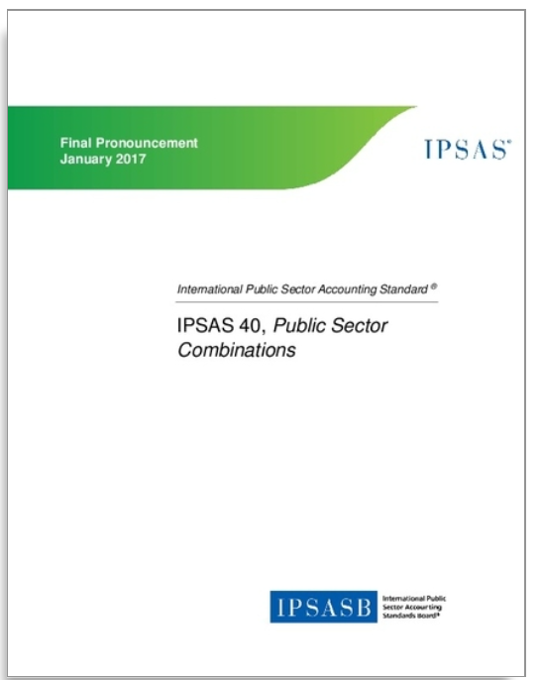
IPSAS 40 Public Sector Combinations - Introduction
IPSAS 40 total of 176 pages
Standard – 29 pages
Application Guidance – 23 pages
Amendments to other IPSASs – 44 pages
Basis for Conclusions – 20 pages
Illustrative Examples – 60 pages
Objectives
To develop a single standard dealing with all public sector combinations
To provide appropriate principles and requirements for both acquisitions (converged with IFRS 3) and amalgamations
To enhance consistency and comparability
6
Notes:
Issued in January 2017

Slide 7
IPSAS 40 — Classification of Combination
Is the combination an acquisition or amalgamation?
Does one party gain control of operations?
Yes
Acquisition method
Recognise acquired assets/liabilities at fair value
Differences recognised as goodwill , loss or gain
Acquisition
No
No
Is the economic substance of the combination that of an amalgamation?
Modified pooling of interest method
Recognise acquired assets/liabilities at carrying amounts
Differences within net asset/equity
Amalgamation
Yes
7
Notes:
Step 1: If no party to a public sector combination gains control of one or more operations as a result of the combination, the combination shall be classified as an amalgamation.
In determining whether one party to a public sector combination gains control or one or more operations as a result of the combination, an entity applies the principles and guidance in IPSAS 36 Consolidated Financial Statements.
Thus, an entity gains control of an operations, if and only if the entity gains all the following:
Power over the operation
Exposure, or rights, to variable benefits
The ability to use its power over the operation to affect the nature of amount of the benefits from its involvement with the operation.
Step 2: The gaining of control of operations by a party to the combination is an essential element of an acquisition, but is not sufficient in itself to determine whether a combination is an acquisition.
Consequently, where one party to the combination gains control of operations, other indicators that may provide evidence that the combination is an amalgamation – consideration and decision-making – require consideration.
The indicators provided in the standard are considered individually or in combination – at the end of the day the preparer is required to make judgement call over the substance of the transaction.
The process is summarized in this diagram:
 Does one party to the combination gain control of operations?  If the answer is no, the combination is an amalgamation.
 If the answer is yes, there is a need to consider the economic substance of the combination, and whether this is that of an amalgamation
 If there is evidence that the economic substance of the combination is that of an amalgamation, the combination is an amalgamation.
 If there is evidence that the economic substance of the combination is that of an acquisition – which includes cases where there is no evidence that the economic substance of the combination is that of an amalgamation – the combination is an acquisition.

Slide 8

Accounting considerations for PBE Combinations
Determining the substance of the combination – acquisition or amalgamation
Measuring fair value of assets and liabilities acquired (difficulties can arise when assets have a restricted use)
Outcome of combination − new entity or continuing entity
Reporting of comparatives
Equity reserves and legacy assets carried over, which are funded from contributions from previous owners/members
Interests in other entities, for example a charitable trust
Previously unrecognised assets or liabilities
Different accounting policies

Slide 9
Questions
Notes:
We will take a pause for any comments or questions

Slide 10
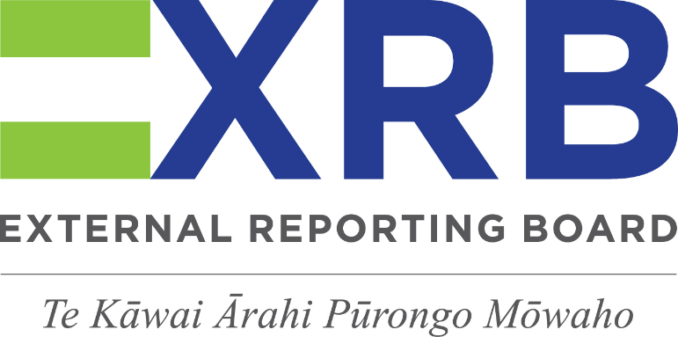
Disclaimer
This presentation provides personal views of the presenter and does not necessarily represent the views of the XRB or other XRB staff. Its contents are for general information only and do not constitute professional advice. The XRB expressly disclaims all liability for any loss or damages arising from reliance upon any information in this presentation. The contents of this presentation is not to be reproduced, distributed or referred to in a public document without the express prior approval of XRB staff.

